Slide 1
Autoencoders

Slide 2
Simple Autoencoder (AE)
An autoencoder is a type of artificial neural network designed for unsupervised learning.
It consists of two main components: an encoder and a decoder. The primary goal of an autoencoder is to learn a compact representation of input data, typically for the purpose of data compression, feature learning, or denoising.
Encoder
Decoder
Input
Input

Slide 3
Autoencoder Training
The encoder part of the autoencoder compresses the input data into a lower-dimensional representation, often referred to as the "latent space" or "encoding."
Encoder
The decoder reconstructs the original input data from the compressed representation produced by the encoder. The reconstructed output should ideally be a close approximation of the original input.
Decoder

Slide 4
Autoencoder Training
By training the autoencoder on a dataset and minimizing the reconstruction error, the model learns to capture the most salient features of the data in the latent space
Encoder
Decoder
Absolute
Difference
Input
loss

Slide 5
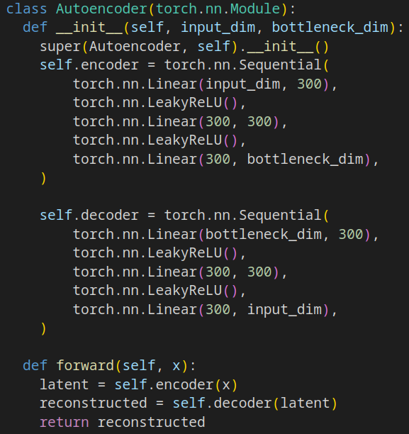
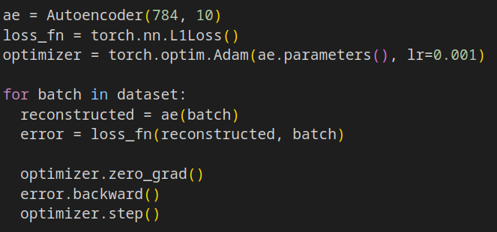
Simple Autoencoder (AE) in PyTorch

Slide 6
Denoising Autoencoder (DAE)
A denoising autoencoder is a variation of the traditional autoencoder designed to handle noisy input data.
The primary objective of a denoising autoencoder is to learn a robust representation of the underlying structure in data by removing noise
Random
Noise
Encoder
Decoder
Absolute
Difference
Input
+
loss

Slide 7
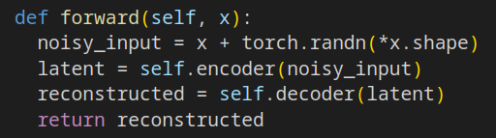
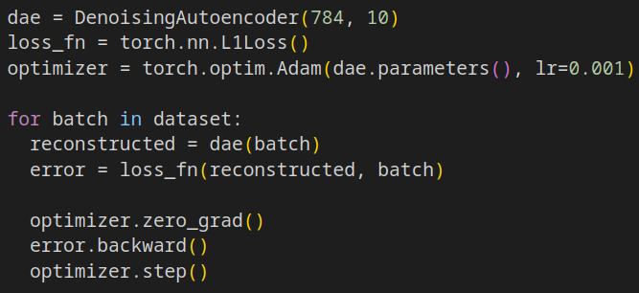
Denoising Autoencoder (DAE) in PyTorch

Slide 8
Variational Autoencoder (VAE)
VAEs are designed to not only learn a compressed representation of input data but also to generate new data points from that learned representation.
Unlike a regular autoencoder that produces a deterministic encoding, VAEs adopt a probabilistic approach. The encoder generates a stochastic compressed representation of the input data.
Encoder
Decoder
Absolute
Difference
Input
Random
Sample
loss

Slide 9
Variational Autoencoder (VAE)
Encoder
Decoder
Absolute
Difference
Input
Random
Sample
loss
This is not a differentiable operation!
How can i run the backpropagation?

Slide 10
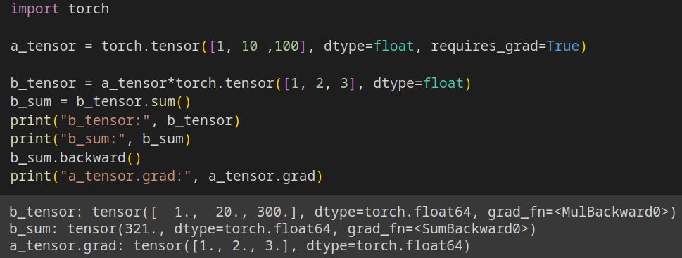
Variational Autoencoder (VAE): Random Sample
This works fine. * and sum() are differentiable operations

Slide 11
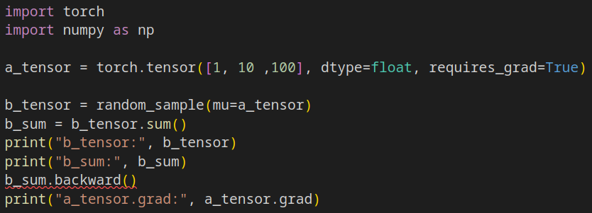
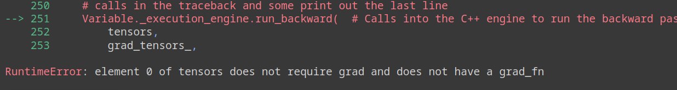
Variational Autoencoder (VAE): Random Sample

Slide 12
Variational Autoencoder (VAE): Random Sample CG
mean
Normal
Random
Sample
Stuff
loss
std
We want to compute the gradients of our loss w.r.t. the mean and the std.
But the Normal Random Sample is a non differentiable operation.
Is there a way out?

Slide 13
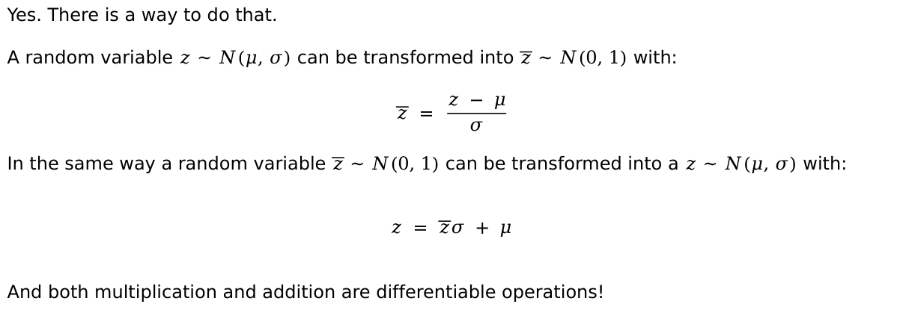
Variational Autoencoder (VAE): Random Sample CG
Yes. There is a way to do that.
A random variable $z \sim N(μ, σ)$ can be transformed into $\overline{z} \sim N(0, 1)$ with:
$$\overline{z} = \frac{z − μ}{σ}$$
In the same way a random variable $\overline{z} \sim N(0, 1)$ can be transformed into a $z \sim N(μ, σ)$ with:
$$z = \overline{z}σ + μ$$
And both multiplication and addition are differentiable operations!

Slide 14
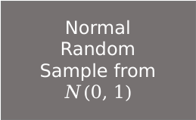
Variational Autoencoder (VAE): Random Sample CG
mean
Stuff
+
loss
std
*
Normal
Random
Sample from
$$N(0, 1)$$
This is called the
reparameterization trick

Slide 15



Variational Autoencoder (VAE): Putting all together
Input
Absolute
Difference
loss
Encoder
Decoder
$$μ$$
+
*
$$σ$$
Sample $N(0, 1)$

Slide 16
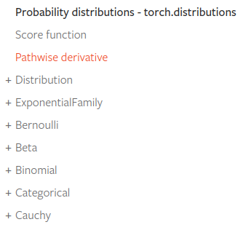
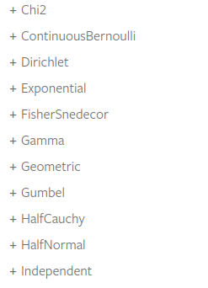
PyTorch: Distributions
The distributions package contains parameterizable probability distributions and sampling functions.
This allows the construction of stochastic computation graphs and stochastic gradient estimators for optimization
Every distribution has the sample() function to compute a new sample. Reparameterizable distributions, on the other hand, possess a special function called rsample() that employs the reparametrization trick to compute a new sample.

Slide 17
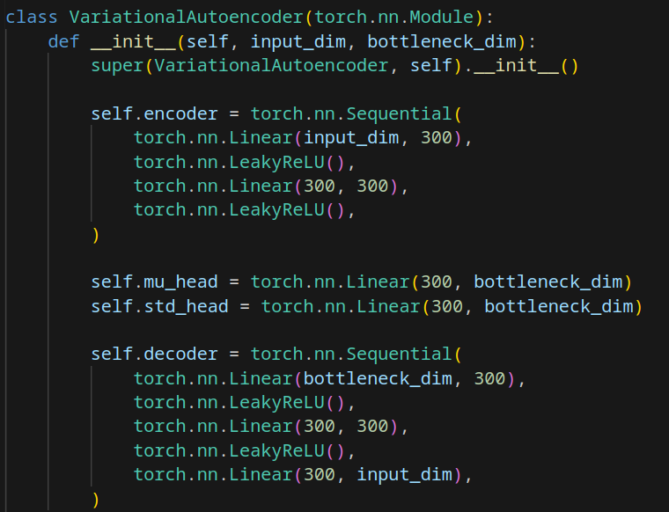
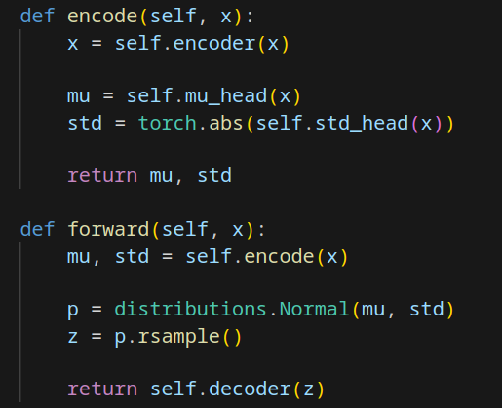
Variational Autoencoder (VAE): In PyTorch

Slide 18

VAE Training Regularization: KL-divergence
The Kullback-Leibler divergence (KL-divergence), is a measure of how one probability distribution diverges from a second, expected probability distribution.
It quantifies the difference between two probability distributions.
In a Variational Autoencoder (VAE), the addition of the KL-divergence term serves as a regularization mechanism during training.
In this context KL-divergence is used to encourage the learned latent distribution to approximate a uncorrelated multivariate distribution

Slide 19
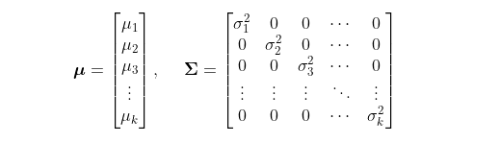
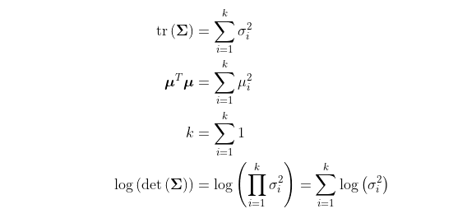
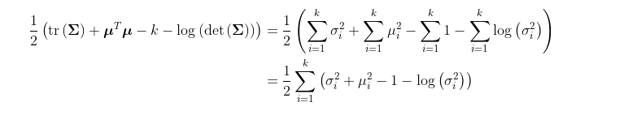
VAE Training Regularization: KL-divergence
We want our learned
representation to be like this

Slide 20
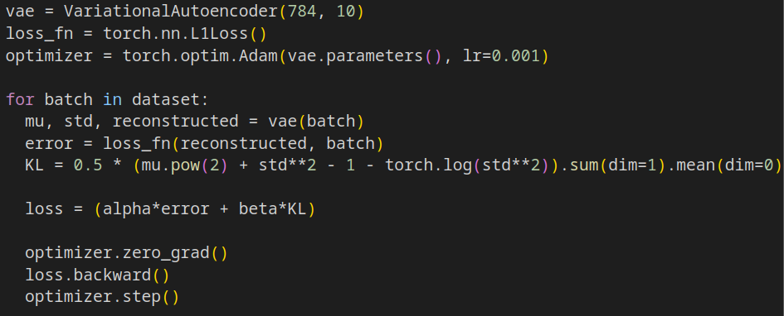
VAE Training Regularization: KL-divergence in PyTorch

Slide 21
FaceSwap Architecture: Training
FaceSwap is based on two Autoencoders (usually denoising)
Face A
Encoder
(shared)
Decoder
A
Face A
Face B
Encoder
(shared)
Decoder
B
Face B

Slide 22
FaceSwap Architecture: Inference
Face A
Encoder
(shared)
Decoder
A
Face A
(exp B)
Face B
Encoder
(shared)
Decoder
B
Face B
(exp A)

Slide 23
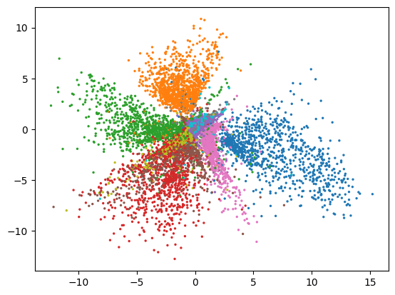
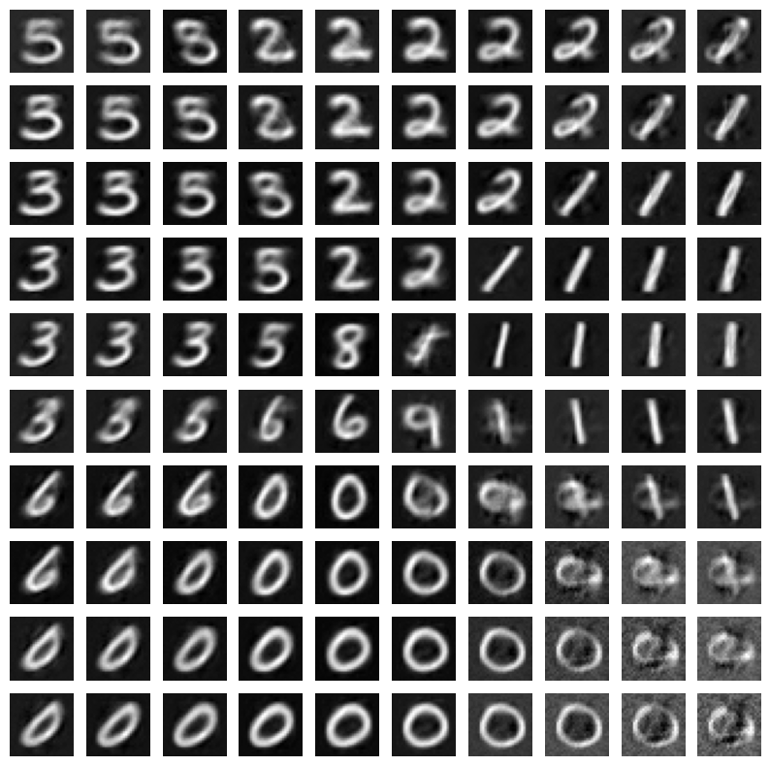
Exercise 1
Train a simple Autoencoder on the MNIST dataset.
Use a latent space of dimension 2
Encode all the digits in the test set and plot a scatterplot of the encoder’s latent space
Plot a map of the recostructed digits from the latent space

Slide 24
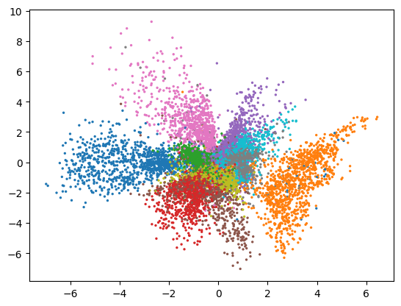
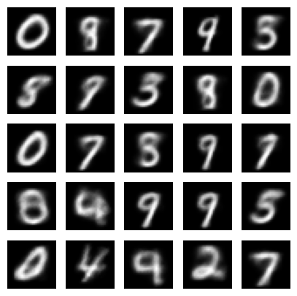
Exercise 2
Train a Variational Autoencoder on the MNIST dataset.
Use a latent space of dimension 2 (2 mu and 2 std)
Encode all the digits in the test set and plot a scatterplot of the encoder’s mu
Plot some reconstructed digits random sampling the latent space

